Slide 1
網站漏洞分析與實務
報告者: 鄭勝峰
指導教授: 曾龍

Slide 2
Agenda
網站的資安威脅
從OWASP TOP 10 到OWASP API TOP 10
DVWA 測試平台
DVWA實戰: command injection
DVWA實戰: SQLI
DVWA實戰: XSS
DVWA實戰: File upload

Slide 3
網站的資安威脅

Slide 4
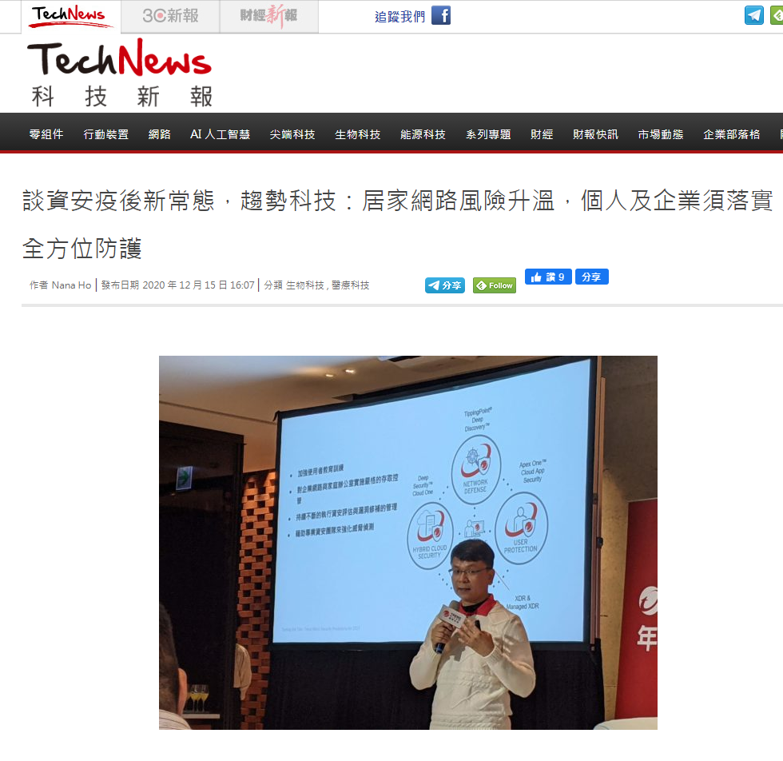
網站的資安威脅
https://technews.tw/2020/12/15/trend-micro-2021-report/

Slide 5
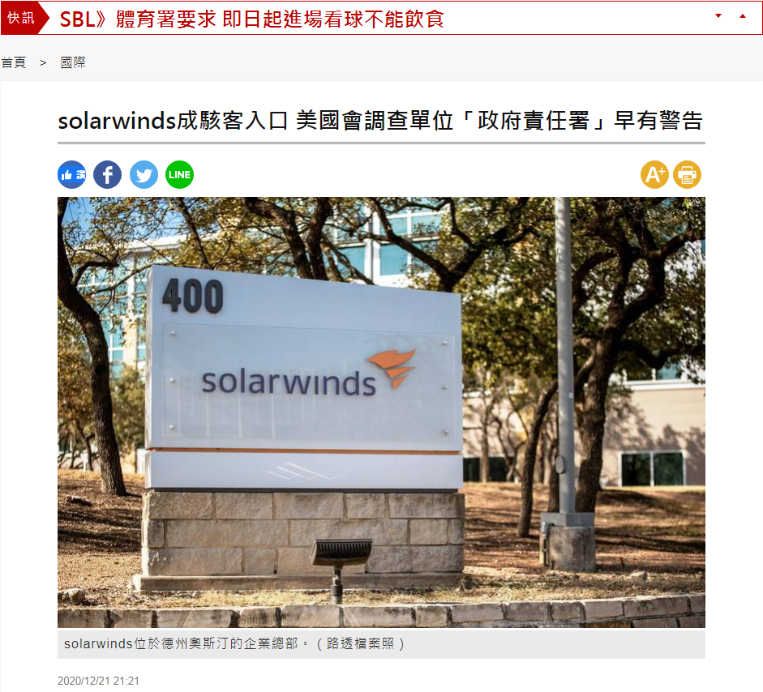
網站的資安威脅
https://news.ltn.com.tw/news/world/breakingnews/3388170

Slide 6
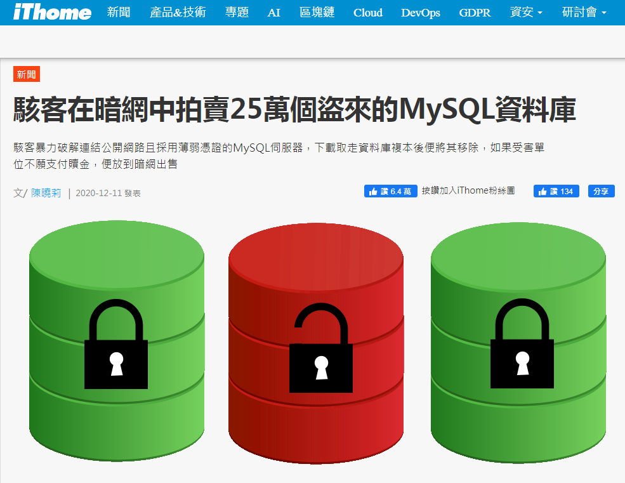
網站的資安威脅
https://www.ithome.com.tw/news/141613

Slide 7
從OWASP TOP 10 到OWASP API TOP 10

Slide 8
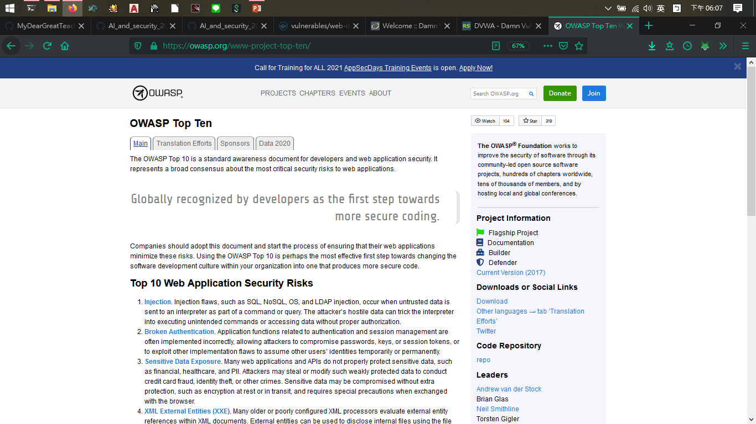
OWASP TOP TEN
https://owasp.org/www-project-top-ten/

Slide 9
Injection
Broken Authentication
Sensitive Data Exposure
XML External Entities (XXE)
Broken Access Control
Security Misconfiguration
Cross-Site Scripting (XSS)
Insecure Deserialization
Using Components with Known Vulnerabilities
Insufficient Logging & Monitoring

Slide 10
Injection
Injection flaws, such as SQL, NoSQL, OS, and LDAP injection, occur when untrusted data is sent to an interpreter as part of a command or query. The attacker’s hostile data can trick the interpreter into executing unintended commands or accessing data without proper authorization.

Slide 11
當將不受信任的數據作為命令或查詢的一部分發送到解釋器時，會發生注入缺陷，例如SQL，NoSQL，OS和LDAP注入。 攻擊者的敵對數據可能會誘使解釋器執行未經預期的命令或未經適當授權而訪問數據。

Slide 12
Broken Authentication
Application functions related to authentication and session management are often implemented incorrectly, allowing attackers to compromise passwords, keys, or session tokens, or to exploit other implementation flaws to assume other users’ identities temporarily or permanently.

Slide 13
與身份驗證和會話管理相關的應用程序功能通常會錯誤地實現，從而使攻擊者能夠破壞密碼，密鑰或會話令牌，或者利用其他實現缺陷來臨時或永久地假定其他用戶的身份。

Slide 14
Sensitive Data Exposure
Many web applications and APIs do not properly protect sensitive data, such as financial, healthcare, and PII. Attackers may steal or modify such weakly protected data to conduct credit card fraud, identity theft, or other crimes. Sensitive data may be compromised without extra protection, such as encryption at rest or in transit, and requires special precautions when exchanged with the browser.

Slide 15
許多Web應用程序和API無法正確保護敏感數據，例如金融，醫療保健和PII。 攻擊者可能會竊取或修改這些受保護程度不高的數據，以進行信用卡欺詐，身份盜用或其他犯罪。 敏感數據可能會在沒有額外保護的情況下受到損害，例如靜態加密或傳輸中加密，並且與瀏覽器進行交換時需要採取特殊的預防措施。

Slide 16
XML External Entities (XXE)
Many older or poorly configured XML processors evaluate external entity references within XML documents. External entities can be used to disclose internal files using the file URI handler, internal file shares, internal port scanning, remote code execution, and denial of service attacks.

Slide 17
許多較舊的或配置不當的XML處理器都會評估XML文檔中的外部實體引用。 外部實體可以使用文件URI處理程序，內部文件共享，內部端口掃描，遠程代碼執行和拒絕服務攻擊來公開內部文件。

Slide 18
Broken Access Control
Restrictions on what authenticated users are allowed to do are often not properly enforced. Attackers can exploit these flaws to access unauthorized functionality and/or data, such as access other users’ accounts, view sensitive files, modify other users’ data, change access rights, etc.

Slide 19
通常，對身份驗證用戶允許執行的操作的限制通常未得到正確執行。 攻擊者可以利用這些缺陷來訪問未經授權的功能和/或數據，例如訪問其他用戶的帳戶，查看敏感文件，修改其他用戶的數據，更改訪問權限等。

Slide 20
Security Misconfiguration
Security misconfiguration is the most commonly seen issue. This is commonly a result of insecure default configurations, incomplete or ad hoc configurations, open cloud storage, misconfigured HTTP headers, and verbose error messages containing sensitive information. Not only must all operating systems, frameworks, libraries, and applications be securely configured, but they must be patched/upgraded in a timely fashion.

Slide 21
安全配置錯誤是最常見的問題。 這通常是由於不安全的默認配置，不完整或臨時的配置，開放的雲存儲，錯誤配置的HTTP標頭以及包含敏感信息的冗長錯誤消息的結果。 不僅必須安全地配置所有操作系統，框架，庫和應用程序，而且還必須及時對其進行補丁/升級。

Slide 22
Cross-Site Scripting (XSS)
XSS flaws occur whenever an application includes untrusted data in a new web page without proper validation or escaping, or updates an existing web page with user-supplied data using a browser API that can create HTML or JavaScript. XSS allows attackers to execute scripts in the victim’s browser which can hijack user sessions, deface web sites, or redirect the user to malicious sites.

Slide 23
每當應用程序在未經適當驗證或轉義的情況下在新網頁中包含不受信任的數據，或者使用可以創建HTML或JavaScript的瀏覽器API用用戶提供的數據更新現有網頁時，都會發生XSS漏洞。 XSS允許攻擊者在受害者的瀏覽器中執行腳本，這些腳本可以劫持用戶會話，破壞網站或將用戶重定向到惡意網站。

Slide 24
Insecure Deserialization
Insecure deserialization often leads to remote code execution. Even if deserialization flaws do not result in remote code execution, they can be used to perform attacks, including replay attacks, injection attacks, and privilege escalation attacks.

Slide 25
不安全的反序列化通常會導致遠程執行代碼。 即使反序列化缺陷不會導致遠程執行代碼，也可以將它們用於執行攻擊，包括重播攻擊，注入攻擊和特權提升攻擊。

Slide 26
Using Components with Known Vulnerabilities
Components, such as libraries, frameworks, and other software modules, run with the same privileges as the application. If a vulnerable component is exploited, such an attack can facilitate serious data loss or server takeover. Applications and APIs using components with known vulnerabilities may undermine application defenses and enable various attacks and impacts.

Slide 27
諸如庫，框架和其他軟件模塊之類的組件以與應用程序相同的特權運行。 如果利用了易受攻擊的組件，則此類攻擊可能會導致嚴重的數據丟失或服務器接管。 使用具有已知漏洞的組件的應用程序和API可能破壞應用程序防禦，並造成各種攻擊和影響。

Slide 28
Insufficient Logging & Monitoring
Insufficient logging and monitoring, coupled with missing or ineffective integration with incident response, allows attackers to further attack systems, maintain persistence, pivot to more systems, and tamper, extract, or destroy data. Most breach studies show time to detect a breach is over 200 days, typically detected by external parties rather than internal processes or monitoring.

Slide 29
日誌和監視的不足，再加上事件響應的缺失或無效集成，使攻擊者可以進一步攻擊系統，保持持久性，轉向更多系統以及篡改，提取或破壞數據。 大多數違規研究表明，發現違規的時間超過200天，通常是由外部各方而不是內部流程或監視來檢測。

Slide 30
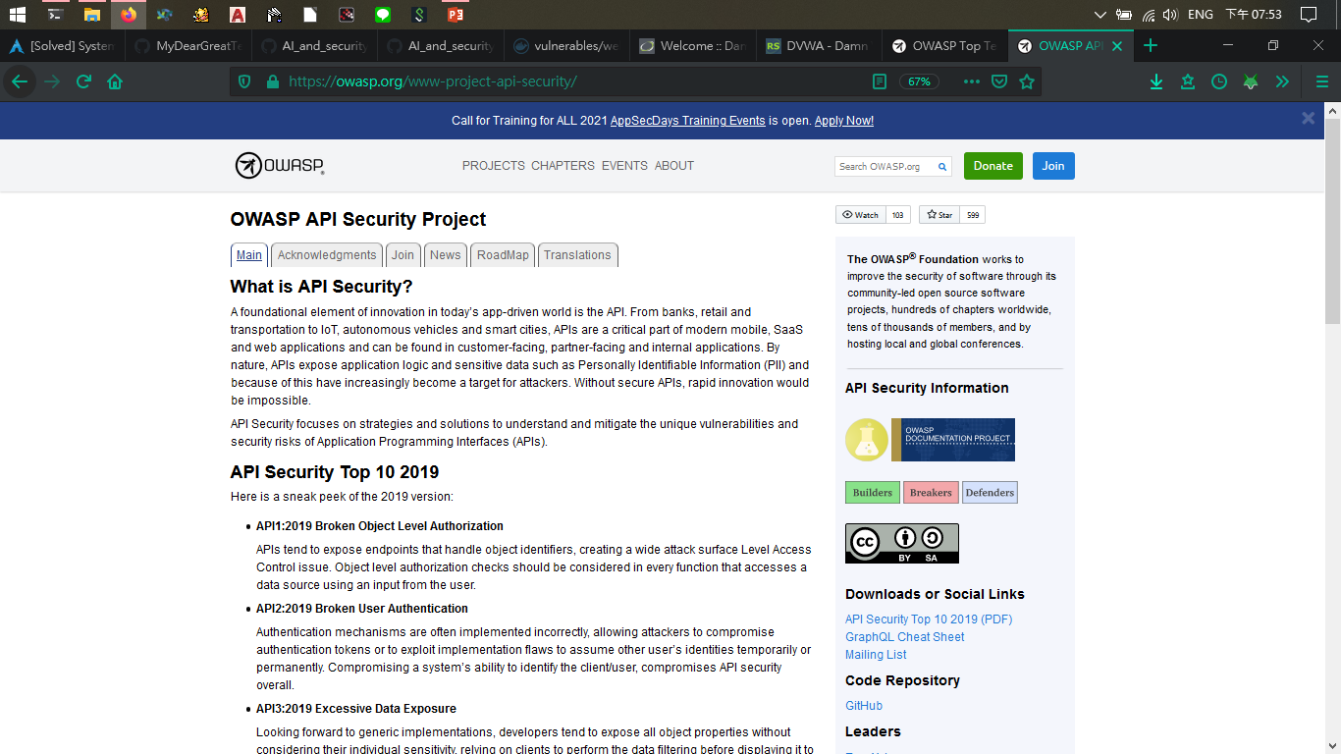
OWASP API TOP TEN

Slide 31
API1:2019 Broken Object Level Authorization
API2:2019 Broken User Authentication
API3:2019 Excessive Data Exposure
API4:2019 Lack of Resources & Rate Limiting
API5:2019 Broken Function Level Authorization
API6:2019 Mass Assignment
API7:2019 Security Misconfiguration
API8:2019 Injection
API9:2019 Improper Assets Management
API10:2019 Insufficient Logging & Monitoring

Slide 32
API1:2019 Broken Object Level Authorization
APIs tend to expose endpoints that handle object identifiers, creating a wide attack surface Level Access Control issue. Object level authorization checks should be considered in every function that accesses a data source using an input from the user.

Slide 33
API傾向於公開處理對象標識符的端點，從而造成廣泛的攻擊面級別訪問控制問題。 在每個使用用戶輸入訪問數據源的功能中，都應考慮對象級別授權檢查。

Slide 34
API2:2019 Broken User Authentication
Authentication mechanisms are often implemented incorrectly, allowing attackers to compromise authentication tokens or to exploit implementation flaws to assume other user’s identities temporarily or permanently. Compromising a system’s ability to identify the client/user, compromises API security overall.

Slide 35
身份驗證機制通常實施不正確，從而使攻擊者可以破壞身份驗證令牌或利用實施缺陷來臨時或永久地假定其他用戶的身份。 損害系統識別客戶端/用戶的能力會整體損害API安全性。

Slide 36
API3:2019 Excessive Data Exposure
Looking forward to generic implementations, developers tend to expose all object properties without considering their individual sensitivity, relying on clients to perform the data filtering before displaying it to the user.

Slide 37
期待通用實現，開發人員傾向於公開所有對象屬性而不考慮其個體敏感性，而是依靠客戶端執行數據過濾，然後再將其顯示給用戶。

Slide 38
API4:2019 Lack of Resources & Rate Limiting
Quite often, APIs do not impose any restrictions on the size or number of resources that can be requested by the client/user. Not only can this impact the API server performance, leading to Denial of Service (DoS), but also leaves the door open to authentication flaws such as brute force.

Slide 39
通常，API不會對客戶端/用戶可以請求的資源大小或數量施加任何限制。 這不僅會影響API服務器的性能，從而導致拒絕服務（DoS），而且還為諸如暴力之類的身份驗證漏洞敞開了大門。

Slide 40
API5:2019 Broken Function Level Authorization
Complex access control policies with different hierarchies, groups, and roles, and an unclear separation between administrative and regular functions, tend to lead to authorization flaws. By exploiting these issues, attackers gain access to other users’ resources and/or administrative functions.

Slide 41
具有不同層次，組和角色的複雜訪問控制策略，以及管理功能和常規功能之間的不清楚的區分，往往會導致授權缺陷。 通過利用這些問題，攻擊者可以訪問其他用戶的資源和/或管理功能。

Slide 42
API6:2019 Mass Assignment
Binding client provided data (e.g., JSON) to data models, without proper properties filtering based on an allowlist, usually leads to Mass Assignment. Either guessing objects properties, exploring other API endpoints, reading the documentation, or providing additional object properties in request payloads, allows attackers to modify object properties they are not supposed to.

Slide 43
將客戶端提供的數據（例如JSON）綁定到數據模型，而沒有基於允許列表進行適當的屬性過濾，通常會導致批量分配。 猜測對象屬性，瀏覽其他API端點，閱讀文檔或在請求有效負載中提供其他對象屬性，都使攻擊者可以修改不應使用的對象屬性。

Slide 44
API7:2019 Security Misconfiguration
Security misconfiguration is commonly a result of unsecure default configurations, incomplete or ad-hoc configurations, open cloud storage, misconfigured HTTP headers, unnecessary HTTP methods, permissive Cross-Origin resource sharing (CORS), and verbose error messages containing sensitive information.

Slide 45
安全性錯誤配置通常是由於不安全的默認配置，不完整或即席配置，開放的雲存儲，錯誤配置的HTTP標頭，不必要的HTTP方法，允許的跨域資源共享（CORS）以及包含敏感信息的冗長錯誤消息導致的。

Slide 46
API8:2019 Injection
Injection flaws, such as SQL, NoSQL, Command Injection, etc., occur when untrusted data is sent to an interpreter as part of a command or query. The attacker’s malicious data can trick the interpreter into executing unintended commands or accessing data without proper authorization.

Slide 47
當將不受信任的數據作為命令或查詢的一部分發送到解釋器時，會發生注入缺陷，例如SQL，NoSQL，命令注入等。 攻擊者的惡意數據可能會誘使解釋器執行未經預期的命令或未經適當授權而訪問數據。

Slide 48
API9:2019 Improper Assets Management
APIs tend to expose more endpoints than traditional web applications, making proper and updated documentation highly important. Proper hosts and deployed API versions inventory also play an important role to mitigate issues such as deprecated API versions and exposed debug endpoints.

Slide 49
與傳統的Web應用程序相比，API傾向於公開更多的端點，這使得正確和更新的文檔非常重要。 適當的主機和已部署的API版本清單在減輕諸如過時的API版本和暴露的調試端點之類的問題方面也起著重要作用。

Slide 50
API10:2019 Insufficient Logging & Monitoring
Insufficient logging and monitoring, coupled with missing or ineffective integration with incident response, allows attackers to further attack systems, maintain persistence, pivot to more systems to tamper with, extract, or destroy data. Most breach studies demonstrate the time to detect a breach is over 200 days, typically detected by external parties rather than internal processes or monitoring.

Slide 51
日誌記錄和監控不足，再加上事件響應的缺失或無效集成，使攻擊者可以進一步攻擊系統，保持持久性，轉向更多系統以篡改，提取或破壞數據。 大多數違規研究表明，檢測到違規的時間超過200天，通常由外部各方而不是內部流程或監視來檢測。

Slide 52
DVWA 測試平台

Slide 53
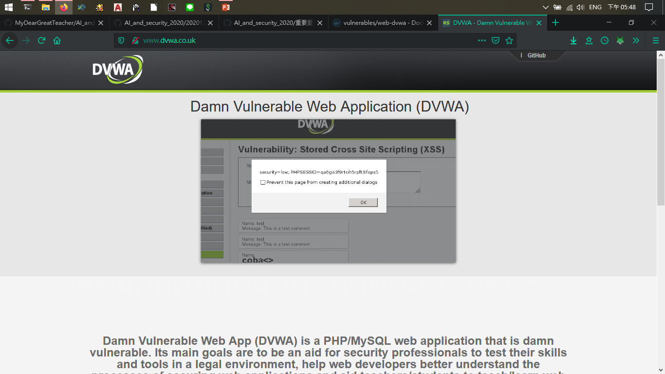
DVWA website
http://www.dvwa.co.uk/

Slide 54
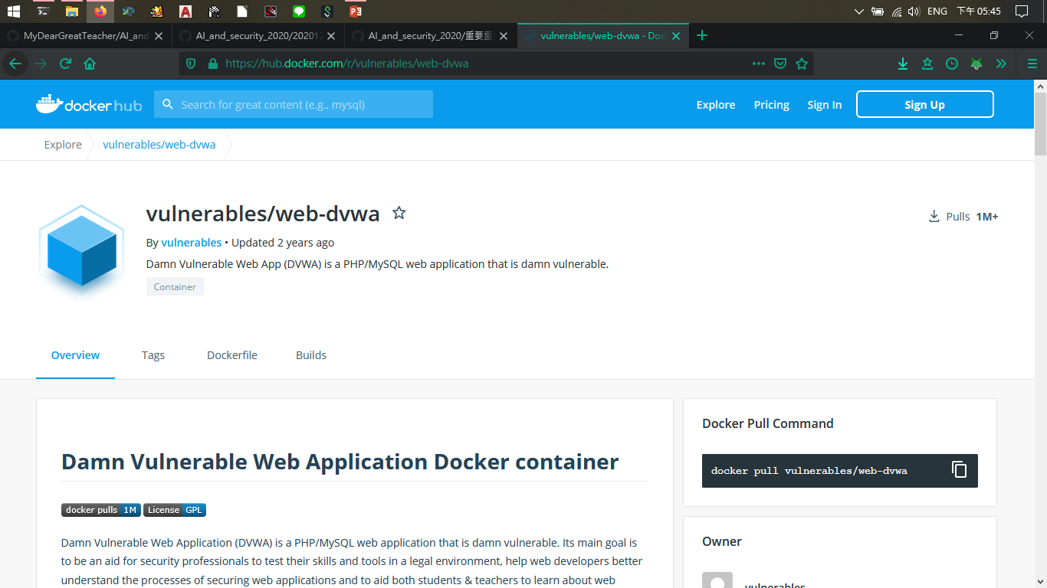
DVWA with docker
https://hub.docker.com/r/vulnerables/web-dvwa

Slide 55
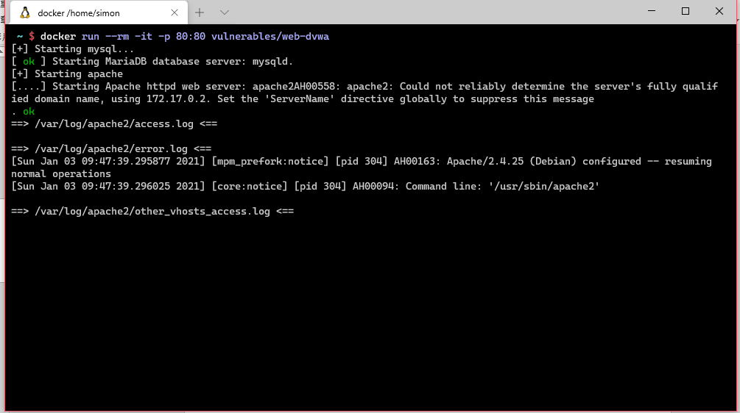
Pull image from docker hub

Slide 56
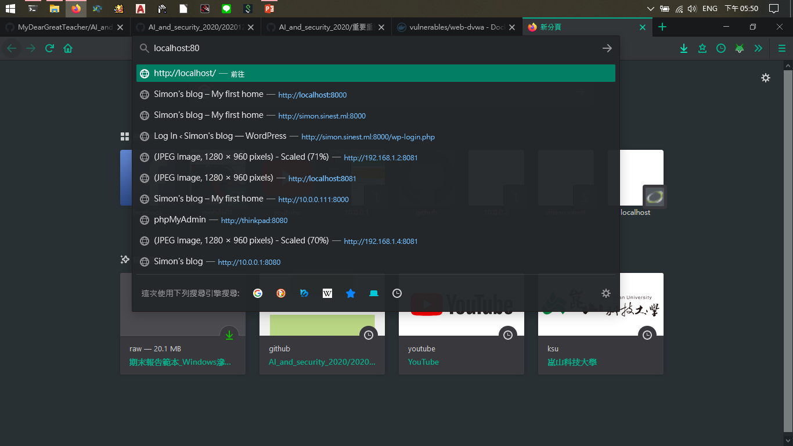
Type localhost:80 in browser search bar

Slide 57
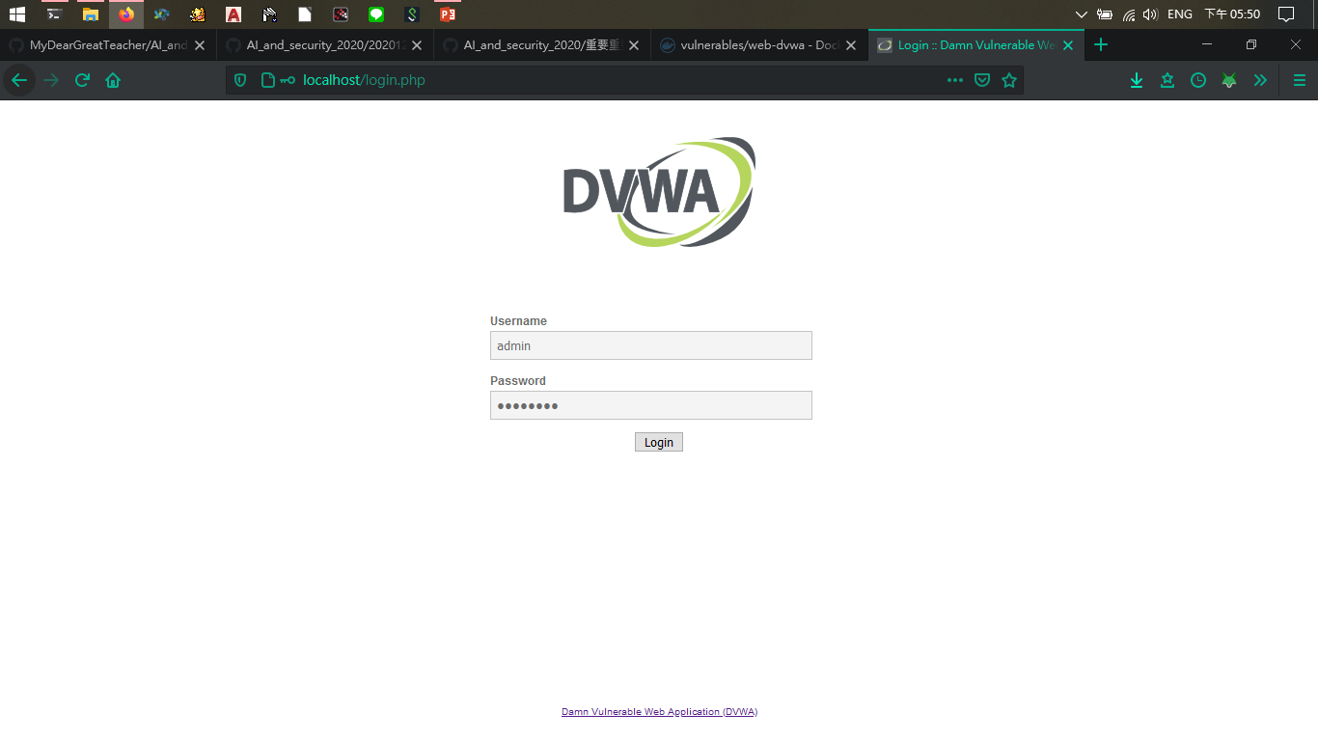
Login
User : admin
Passwd: password

Slide 58
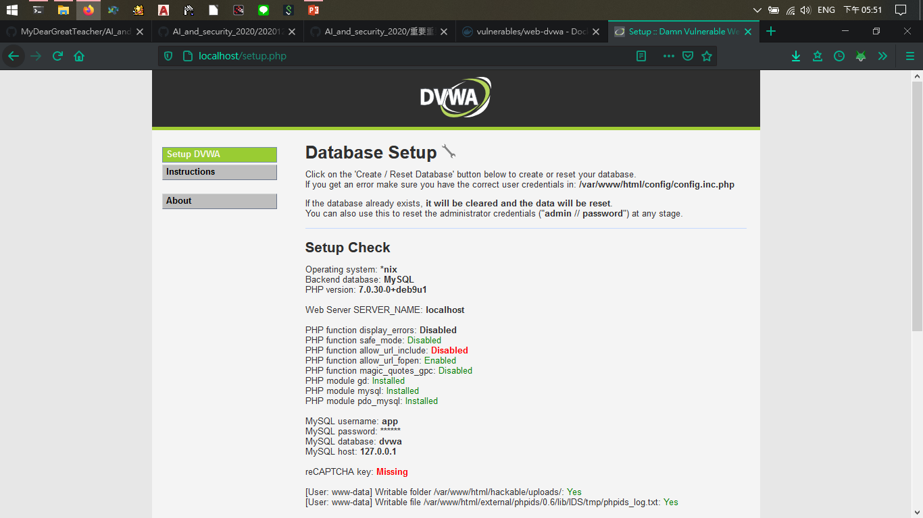
Scroll down to bottom

Slide 59
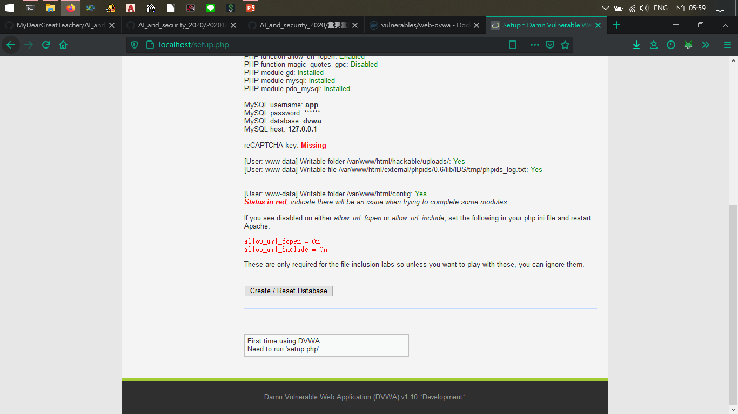
Click it

Slide 60

Login again

Slide 61
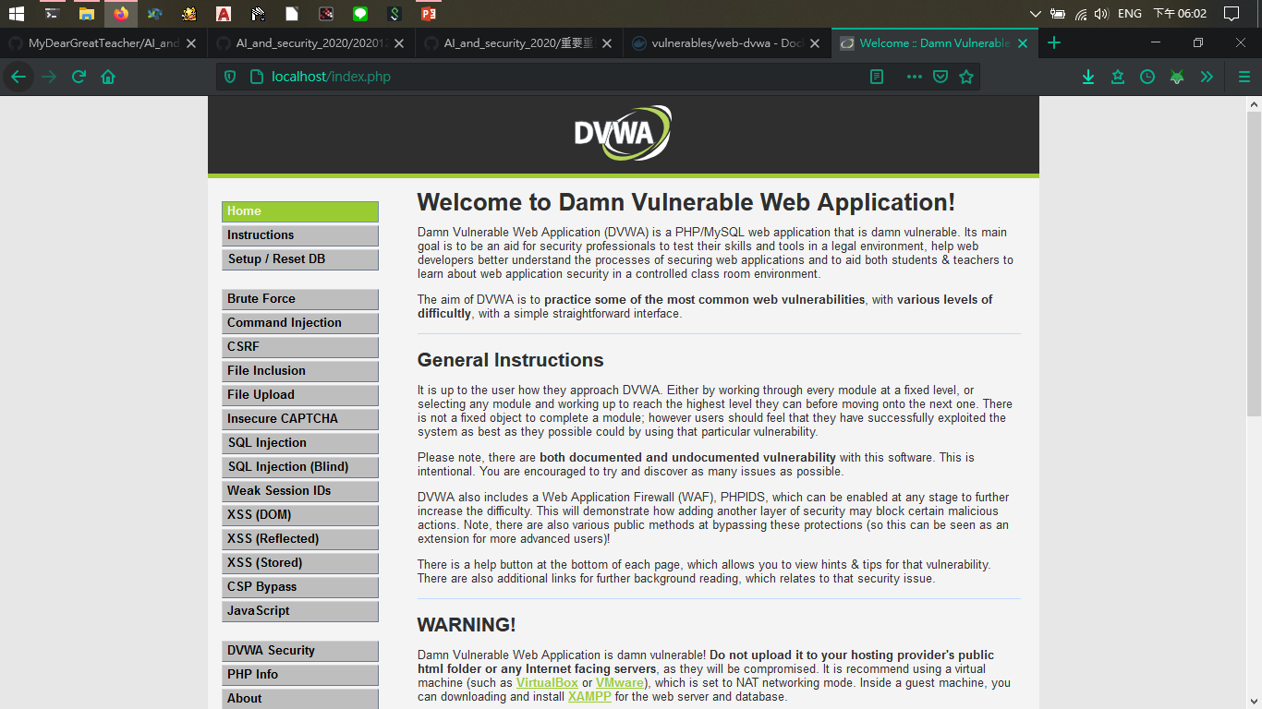
環境建置完成

Slide 62
DVWA實戰:command injection

Slide 63
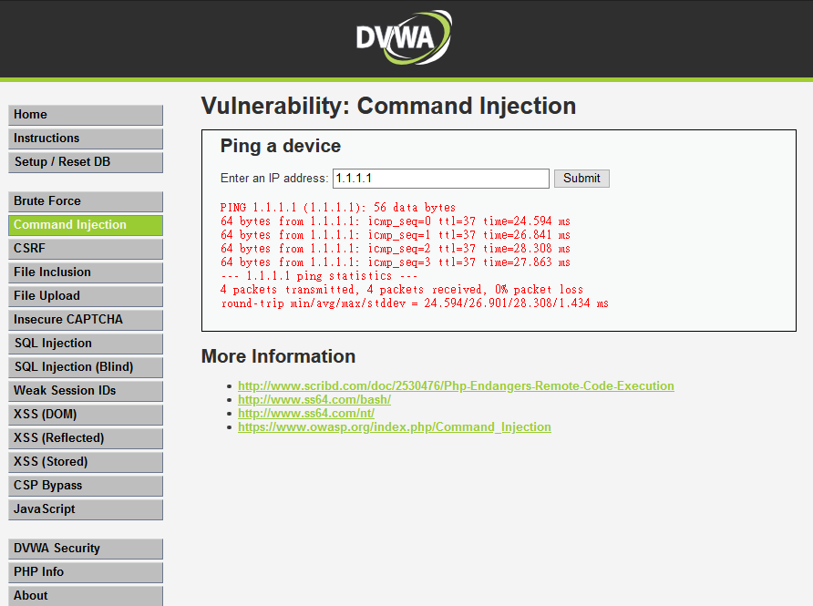
Security Level: Low

Slide 64
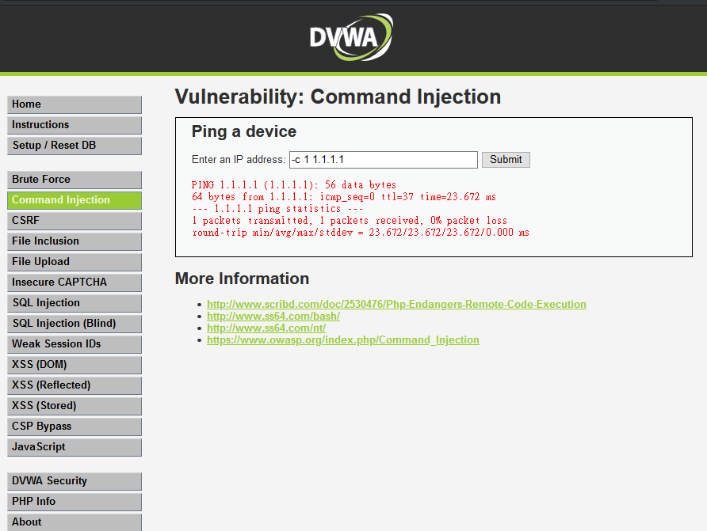

Slide 65
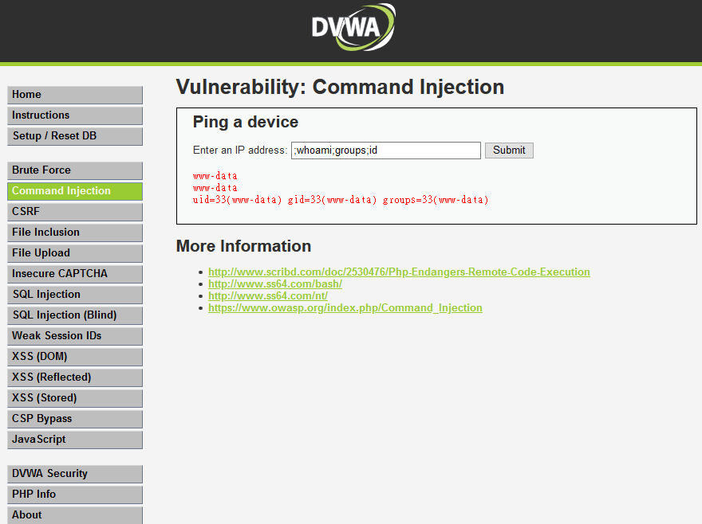

Slide 66
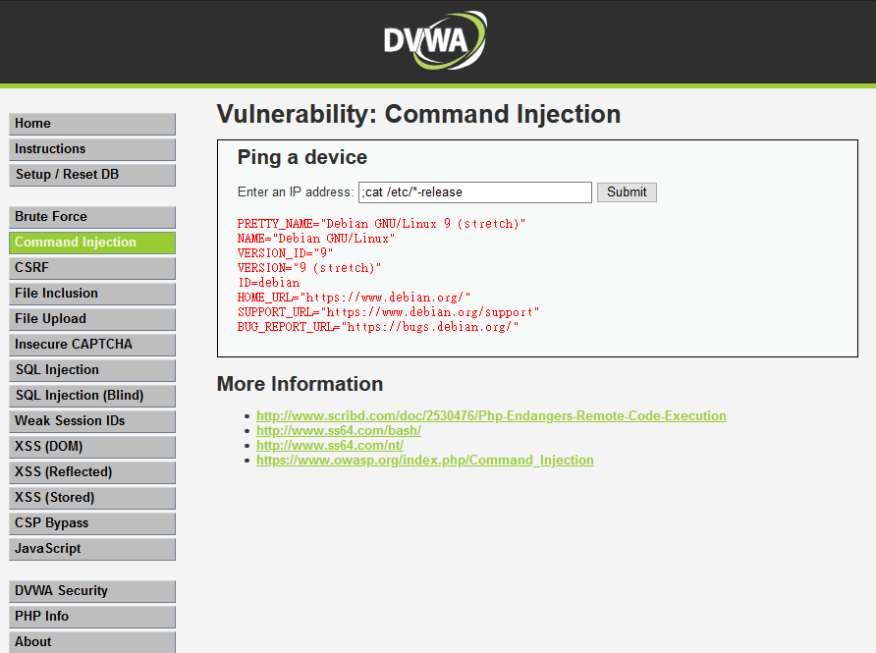

Slide 67
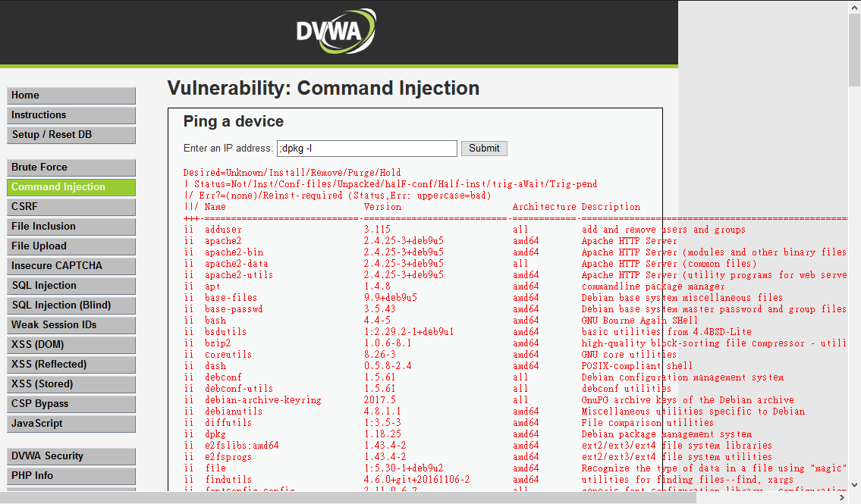

Slide 68
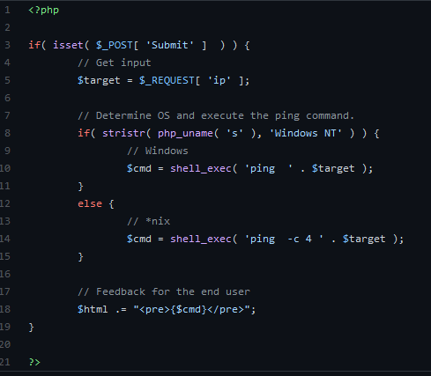
沒有檢查輸入便直接使用

Slide 69
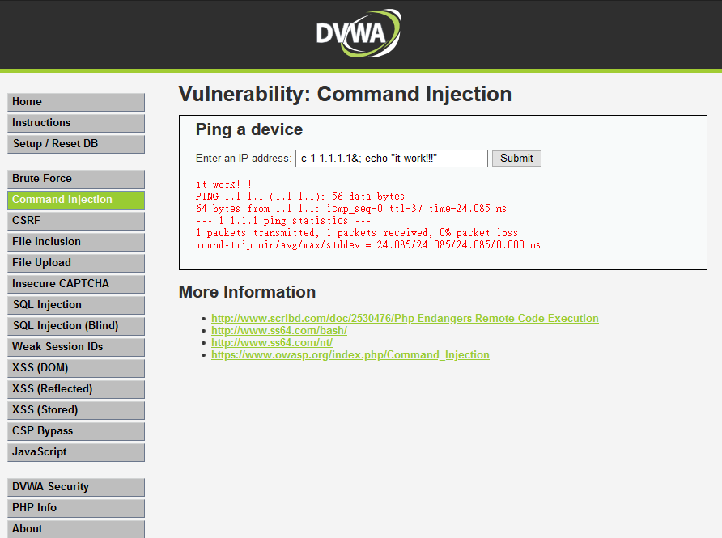
Security Level: Middle

Slide 70
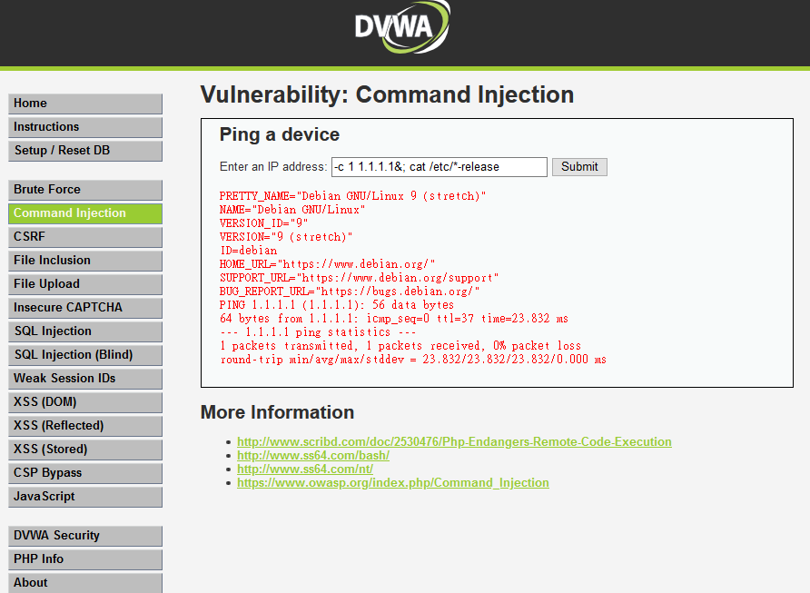

Slide 71
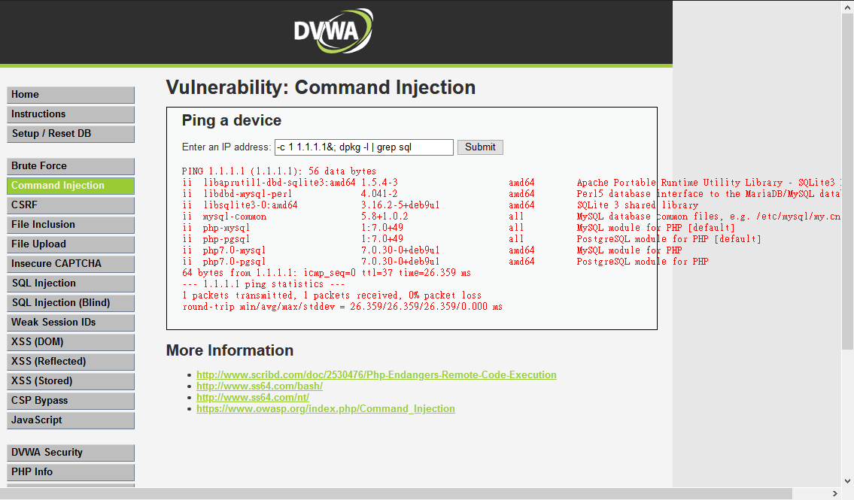

Slide 72
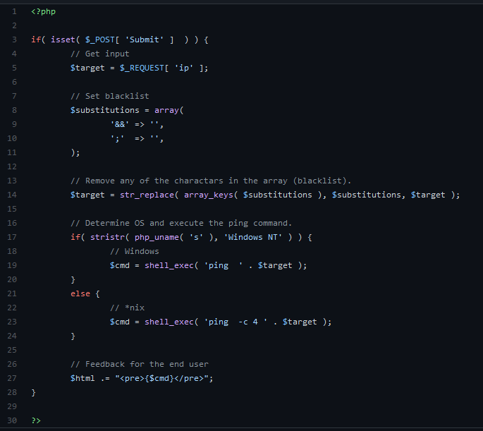
只把輸入中的 && 和 ;換成空字串

Slide 73
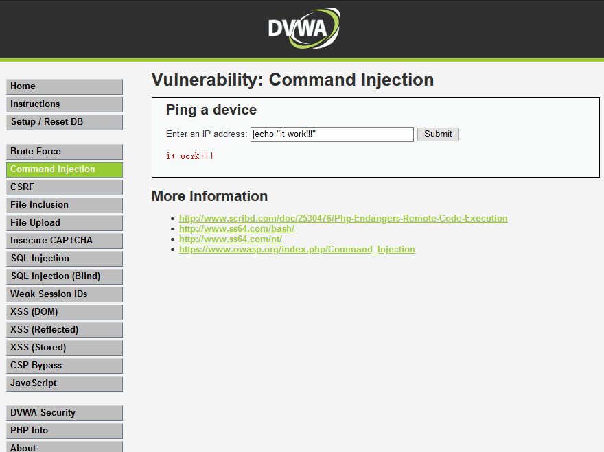
Security Level: High

Slide 74
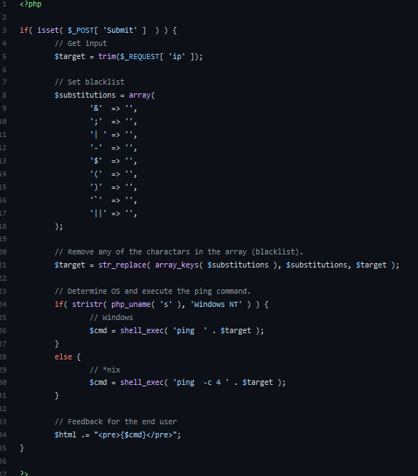
把每一種shell的特殊符號換成空字串，但是 | 後面多了一個空格

Slide 75
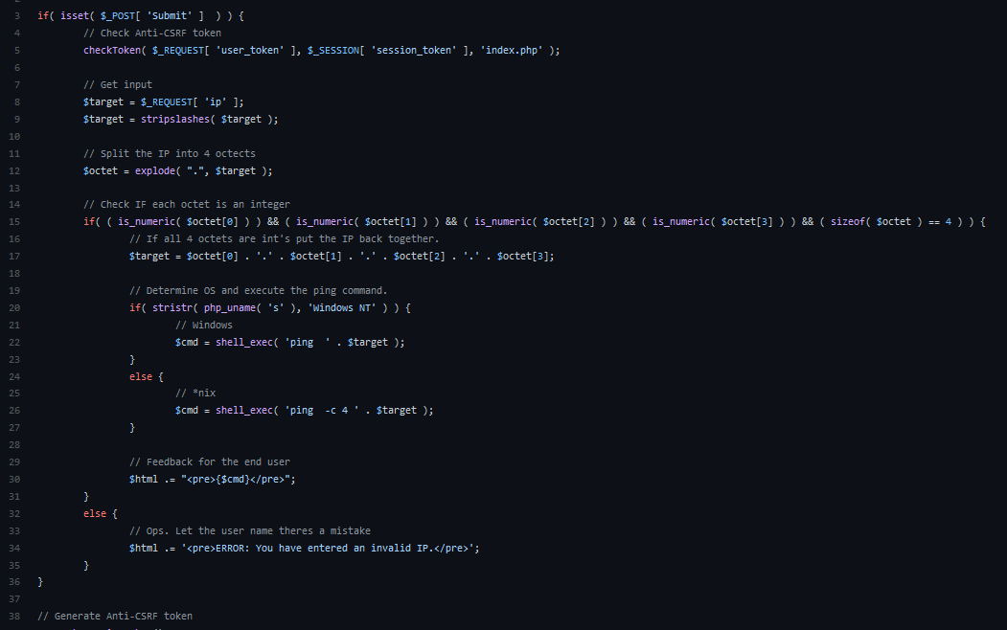
Security Level: Impossible
將輸入用 . 分割後檢查是不是都是整數後再把輸入做應用

Slide 76
DVWA實戰:SQLI

Slide 77
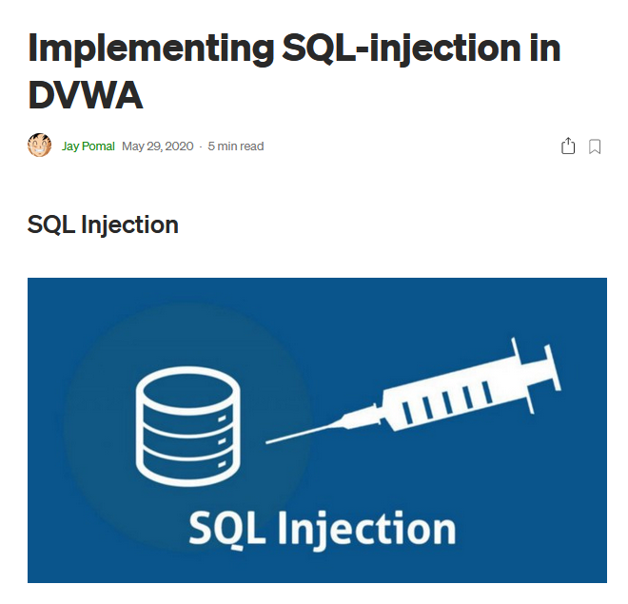
教學
https://jaypomal.medium.com/implementing-sql-injection-in-dvwa-2091879d44a2

Slide 78
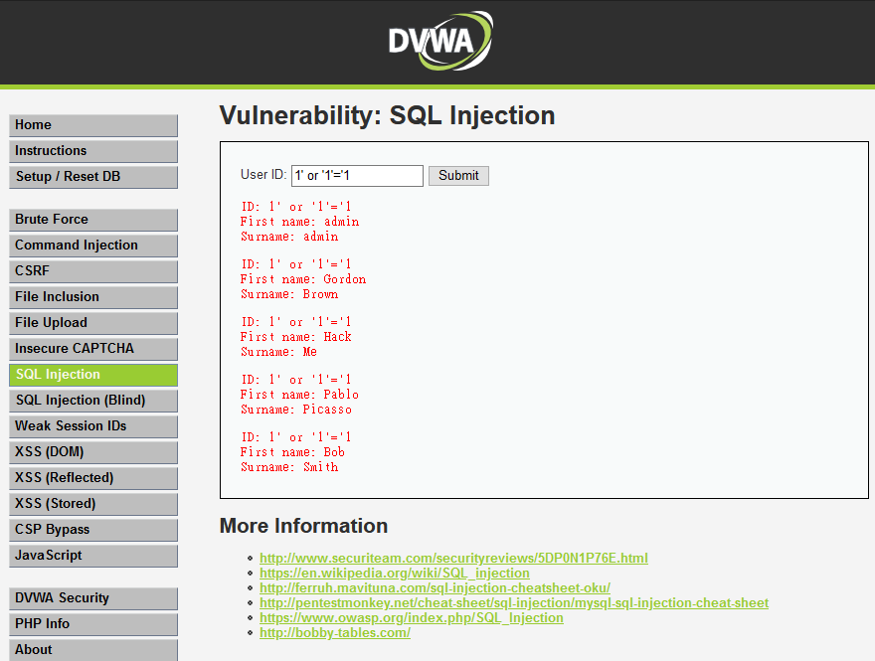
Security Level: Low

Slide 79
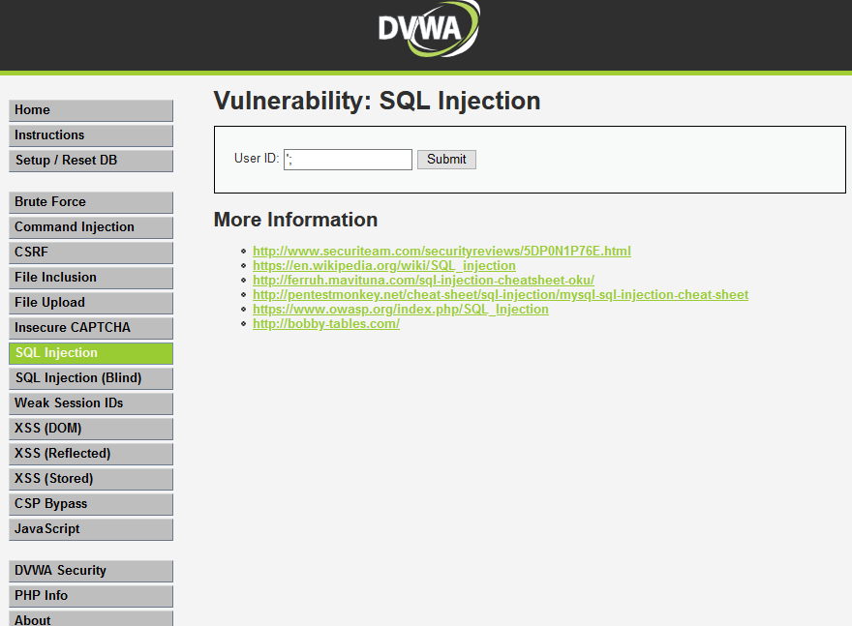

Slide 80
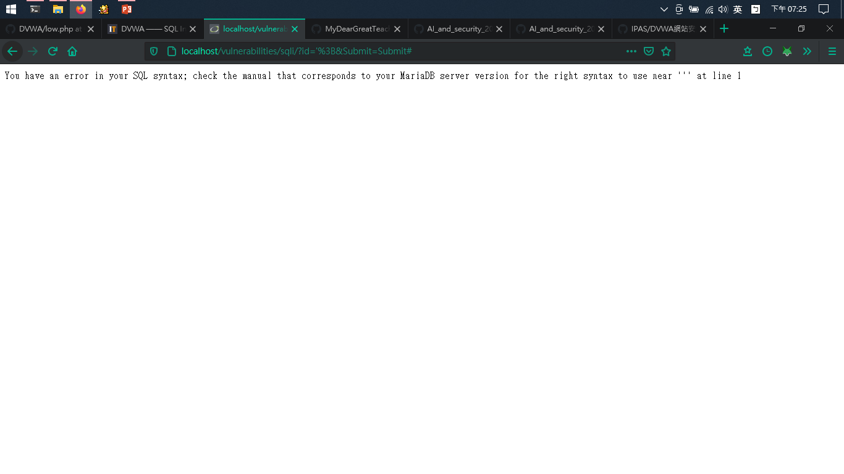

Slide 81
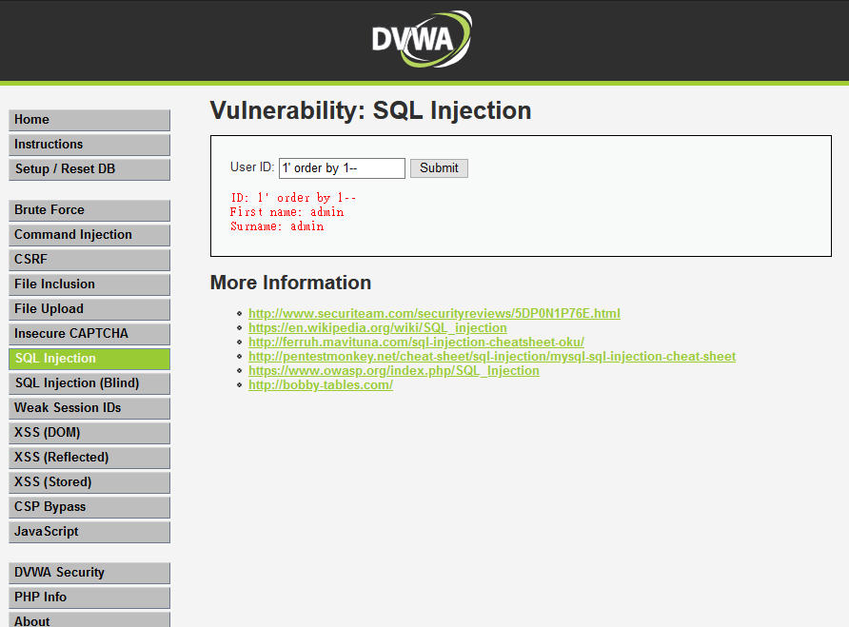

Slide 82


Slide 83
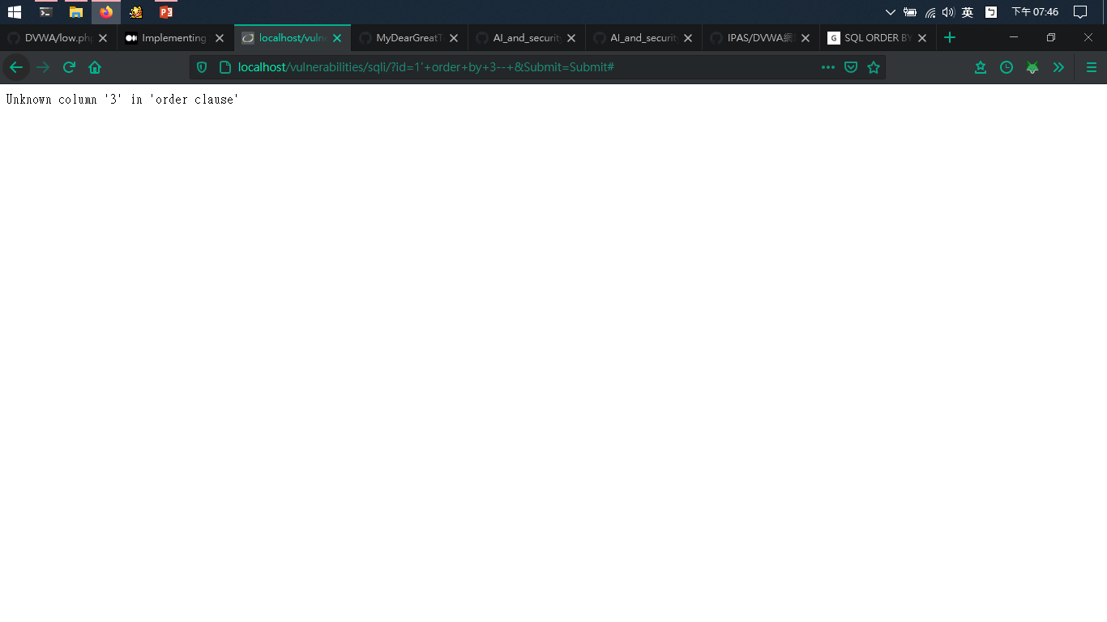

Slide 84
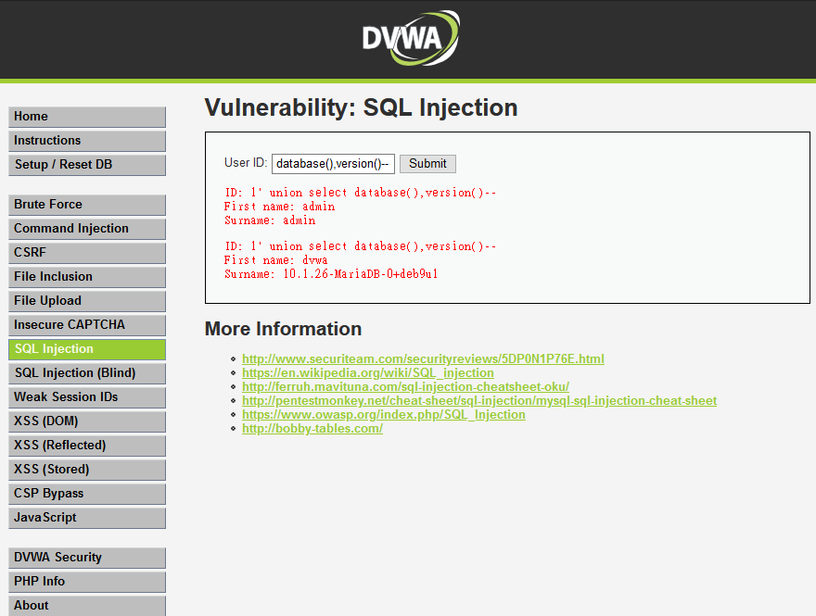

Slide 85
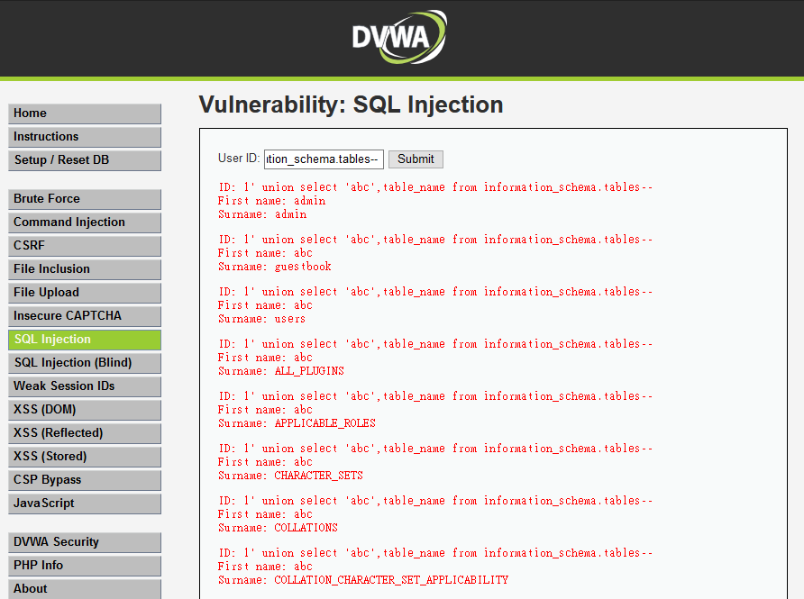

Slide 86
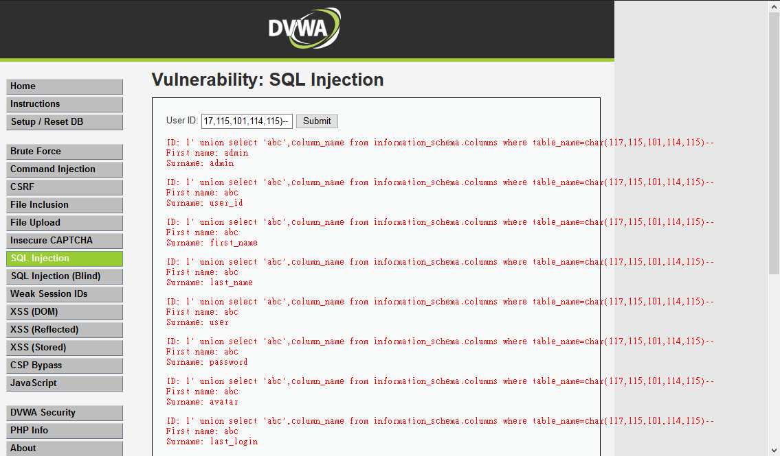

Slide 87
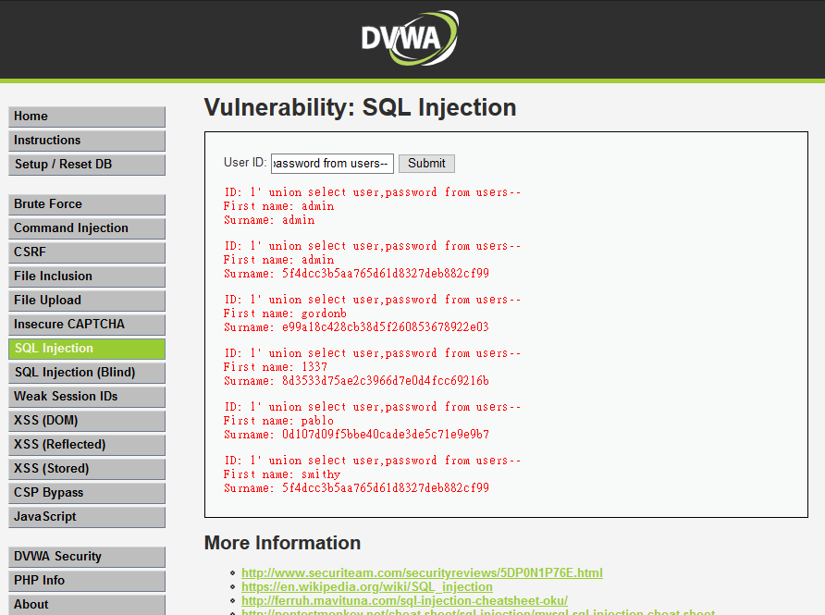

Slide 88
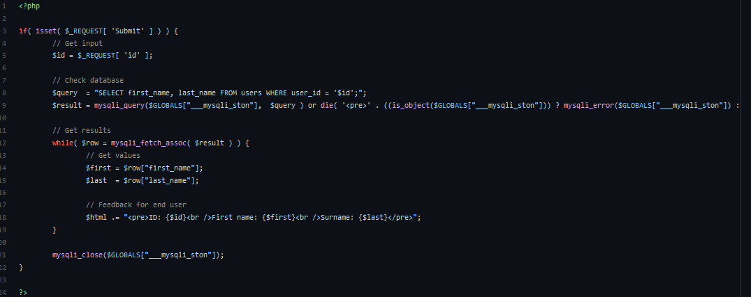

Slide 89
DVWA實戰:XSS

Slide 90
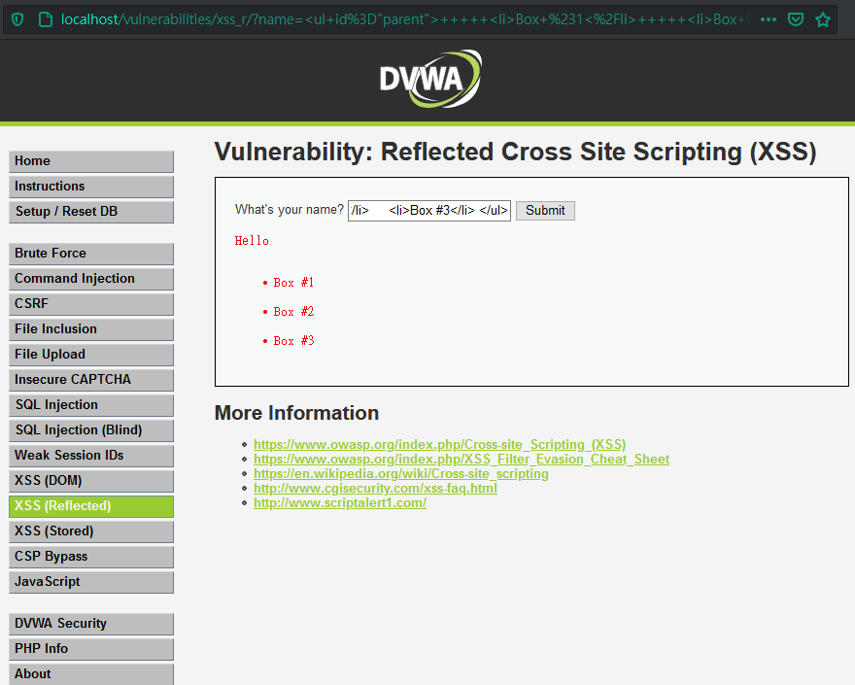
Security Level: Low

Slide 91
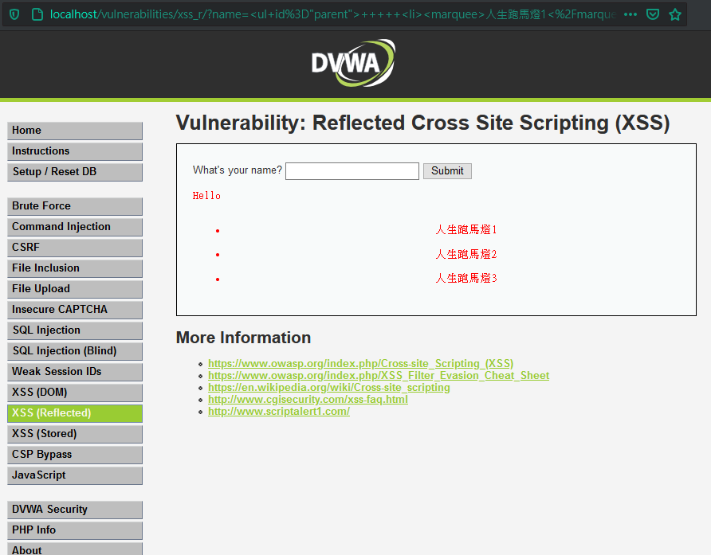

Slide 92
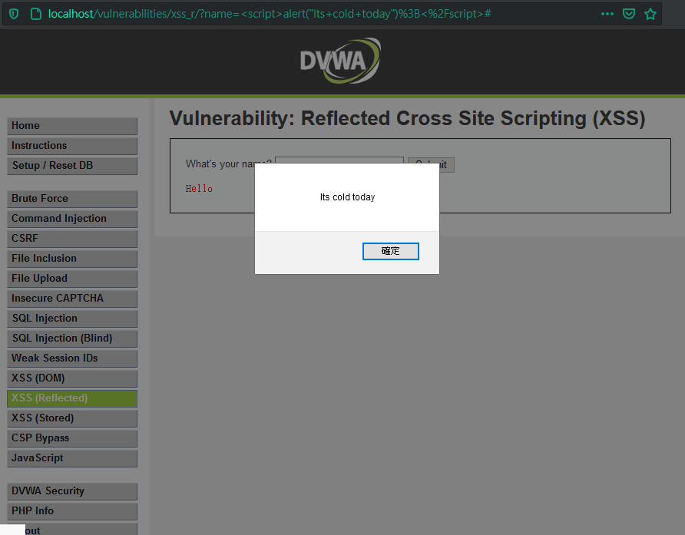
<script>alert("Its cold today");</script>

Slide 93
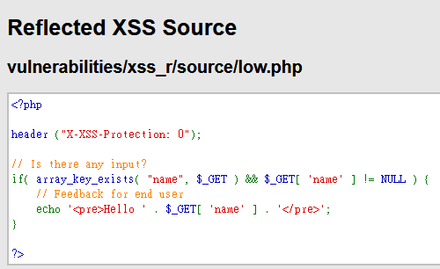
不做輸入檢查

Slide 94
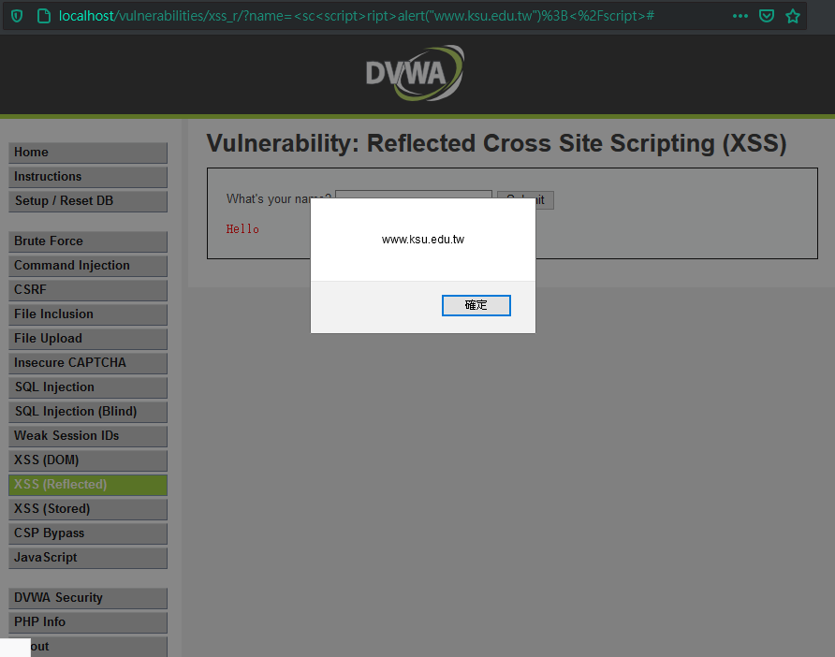
Security Level: Middle
<sc<script>ript>alert("www.ksu.edu.tw");</script>

Slide 95

<ScRipt>alert("123到台灣");</script>

Slide 96
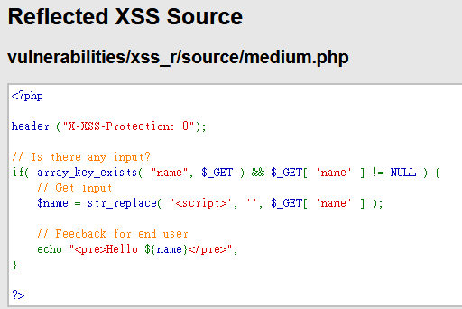
把<script> 換成空字串

Slide 97
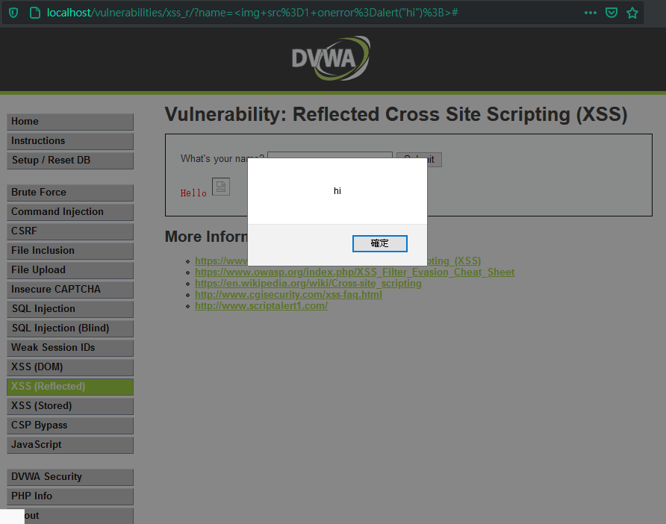
Security Level: High
<img src=1 onerror=alert("hi");>

Slide 98
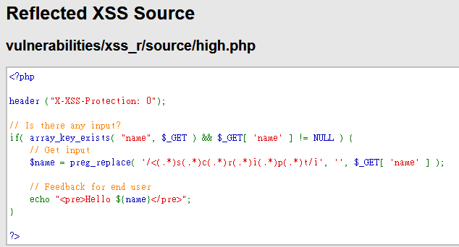
將輸入中任何的<script>換成空字串 但是沒有處理其他HTML語法

Slide 99
File upload

Slide 100
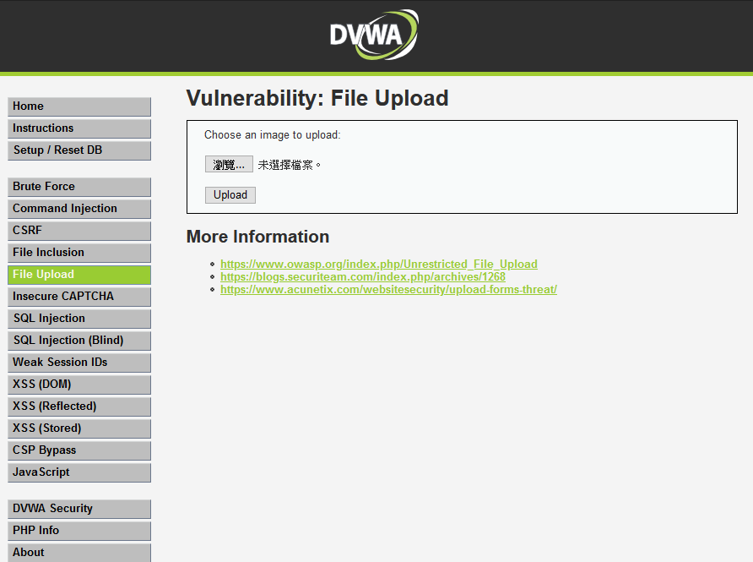
瀏覽並上傳檔案
點瀏覽

Slide 101
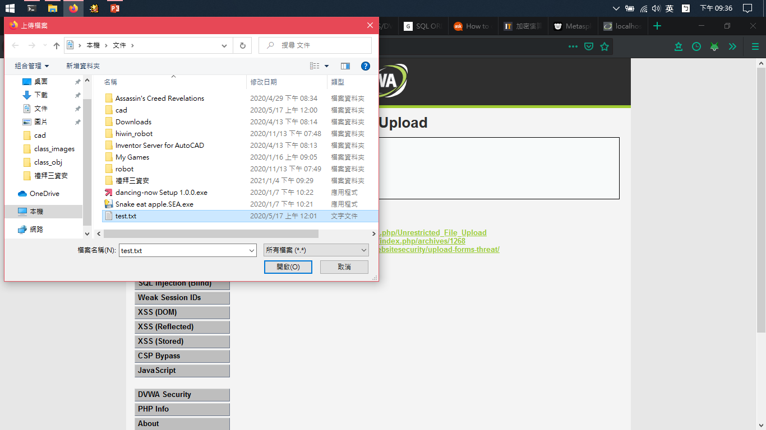
上傳檔案

Slide 102
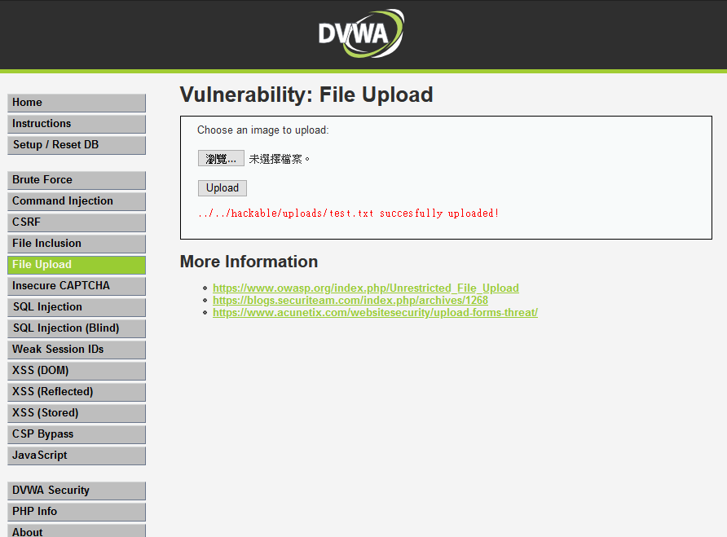
找到上傳檔案的目錄

Slide 103
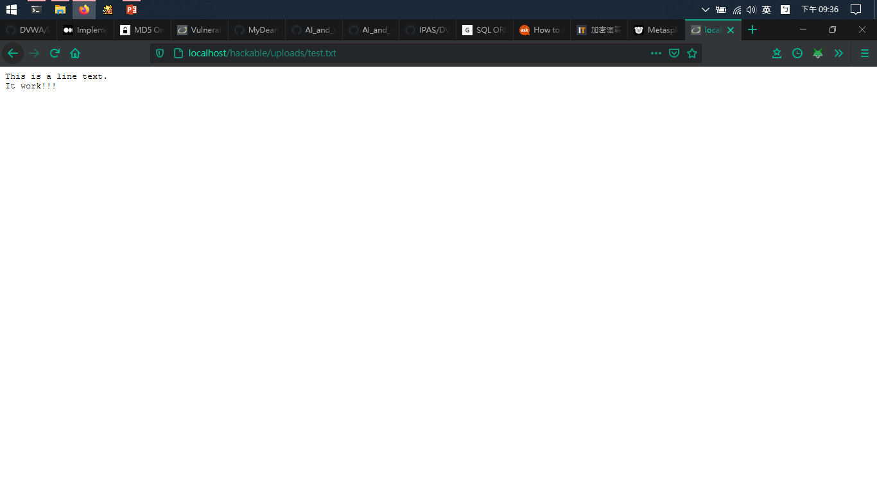

Slide 104
感謝聆聽

